Slide 1
Chapter 4 - Control Structures: Part 1
Outline
4.1 Introduction
4.2 Algorithms
4.3 Pseudocode
4.4 Control Structures
4.5 The if Selection Structure
4.6 The if/else Selection Structure
4.7 The while Repetition Structure
4.8 Formulating Algorithms: Case Study 1 (Counter- Controlled Repetition)
4.9 Formulating Algorithms with Top-Down, Stepwise Refinement: Case Study 2 (Sentinel-Controlled Repetition)
4.10 Formulating Algorithms with Top-Down, Stepwise Refinement: Case Study 3 (Nested Control Structures)
4.11 Assignment Operators
4.12 Increment and Decrement Operators
4.13 Primitive Data Types
4.14 (Optional Case Study) Thinking About Objects: Identifying Class Attributes

Slide 2
4.1 Introduction
We learn about Control Structures
  Structured-programming principle
  Control structures help build and manipulate objects (Chapter 8)

Slide 3
4.2 Algorithms
Algorithm
  Series of actions in specific order
    The actions executed
    The order in which actions execute
Program control
  Specifying the order in which actions execute
    Control structures help specify this order

Slide 4
4.3 Pseudocode
Pseudocode
  Informal language for developing algorithms
  Not executed on computers
  Helps developers “think out” algorithms

Slide 5
4.4 Control Structures
Sequential execution
  Program statements execute one after the other
Transfer of control
  Three control statements can specify order of statements
    Sequence structure
    Selection structure
    Repetition structure
Flowchart
  Graphical representation of algorithm
    Flowlines indicate order in which actions execute

Slide 6
Flowlines
Action Symbols
add grade to total
total = total + grade;
add 1 to counter
counter = counter +
1
;
Connector Symbols
    Fig 4.1 Flowcharting Java’s sequence structure.

Slide 7
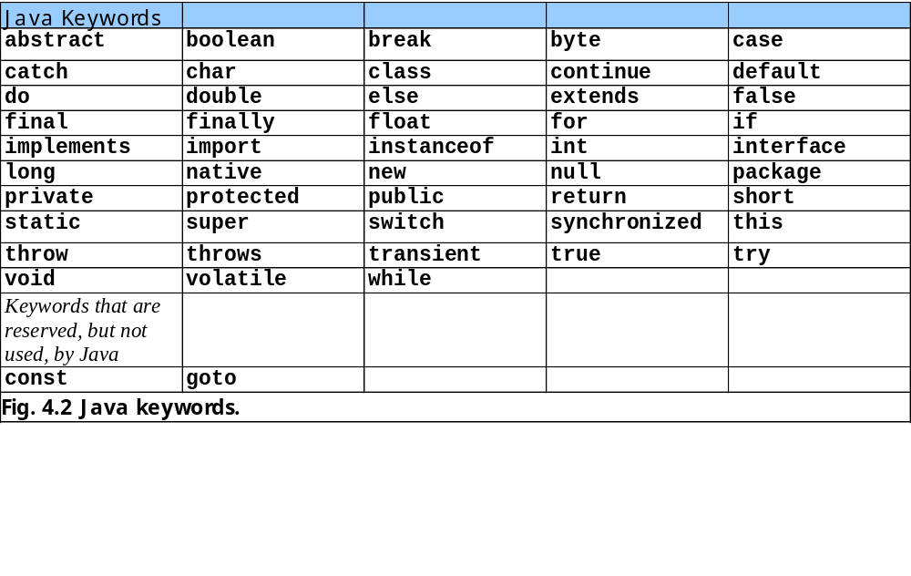

Slide 8
Selection Structures
Java has a sequence structure “built-in”
Java provides three selection structures
  if
  if/else
  switch
Java provides three repetition structures
  while
  do/while
  do
Each of these words is a Java keyword

Slide 9
4.5 The if Selection Structure
Single-entry/single-exit structure
Perform action only when condition is true
Action/decision programming model

Slide 10
Decision Symbol
true
grade >= 60
print “Passed”
false
    Fig 4.3 Flowcharting the single-selection if structure.

Slide 11
4.6 The if/else Selection Structure
Perform action only when condition is true
Perform different specified action when condition is false
Conditional operator (?:)
Nested if/else selection structures

Slide 12
false
true
grade >= 60
print “Failed”
print “Passed”
    Fig 4.4 Flowcharting the double-selection if/else structure.

Slide 13
4.7 The while Repetition Structure
Repeat action while condition remains true

Slide 14
true
product <= 1000
product = 2 * product
false
    Fig 4.5 Flowcharting the while repetition structure.

Slide 15
4.8 Formulating Algorithms: Case Study 1 (Counter-Controlled Repetition)
Counter
  Variable that controls number of times set of statements executes
Average1.java calculates grade averages
  uses counters to control repetition

Slide 16
Set total to zero
Set grade counter to one
While grade counter is less than or equal to ten
Input the next grade
Add the grade into the total
Add one to the grade counter
Set the class average to the total divided by ten
Print the class average
Fig. 4.6 Pseudocode algorithm that uses counter-controlled repetition to solve the class-average problem.

Slide 17
Average1.java gradeCounter
Line 23
1 // Fig. 4.7: Average1.java
2 // Class average program with counter-controlled repetition.
3
4 // Java extension packages
5 import javax.swing.JOptionPane;
6
7 public class Average1 {
8
9 // main method begins execution of Java application
10 public static void main( String args[] )
11 {
12 int total, // sum of grades input by user
13 gradeCounter, // number of grades entered
14 gradeValue, // grade value
15 average; // average of all grades
16 String grade; // grade typed by user
17
18 // Initialization Phase
19 total = 0; // clear total
20 gradeCounter = 1; // prepare to loop
21
22 // Processing Phase
23 while ( gradeCounter <= 10 ) { // loop 10 times
24
25 // prompt for input and read grade from user
26 grade = JOptionPane.showInputDialog(
27 "Enter integer grade: " );
28
29 // convert grade from a String to an integer
30 gradeValue = Integer.parseInt( grade );
31
32 // add gradeValue to total
33 total = total + gradeValue;
34
Declare variables; gradeCounter is the counter
Continue looping as long as gradeCounter is less than or equal to 10

Slide 18
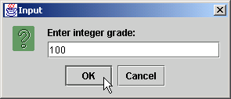
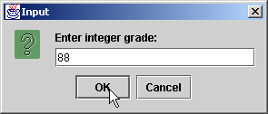
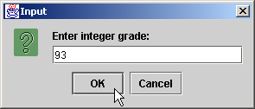

Average1.java
35 // add 1 to gradeCounter
36 gradeCounter = gradeCounter + 1;
37
38 } // end while structure
39
40 // Termination Phase
41 average = total / 10; // perform integer division
42
43 // display average of exam grades
44 JOptionPane.showMessageDialog( null,
45 "Class average is " + average, "Class Average",
46 JOptionPane.INFORMATION_MESSAGE );
47
48 System.exit( 0 ); // terminate the program
49
50 } // end method main
51
52 } // end class Average1

Slide 19
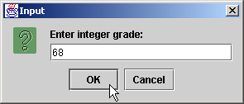
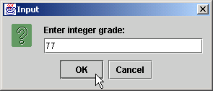


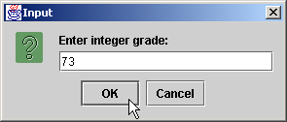

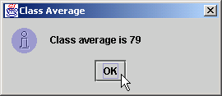
Average1.java

Slide 20
4.9 Formulating Algorithms with Top-Down, Stepwise Refinement: Case Study 2 (Sentinel-Controlled Repetition)
Sentinel value
  Used to indicated the end of data entry
Average2.java has indefinite repetition
  User enters sentinel value (-1) to end repetition

Slide 21
Initialize total to zero
Initialize counter to zero
Input the first grade (possibly the sentinel)
While the user has not as yet entered the sentinel
Add this grade into the running total
Add one to the grade counter
Input the next grade (possibly the sentinel)
If the counter is not equal to zero
Set the average to the total divided by the counter
Print the average
else
Print “No grades were entered”
Fig. 4.8 Pseudocode algorithm that uses sentinel-controlled repetition to solve the class-average problem.

Slide 22
Average2.java
1 // Fig. 4.9: Average2.java
2 // Class average program with sentinel-controlled repetition.
3
4 // Java core packages
5 import java.text.DecimalFormat;
6
7 // Java extension packages
8 import javax.swing.JOptionPane;
9
10 public class Average2 {
11
12 // main method begins execution of Java application
13 public static void main( String args[] )
14 {
15 int gradeCounter, // number of grades entered
16 gradeValue, // grade value
17 total; // sum of grades
18 double average; // average of all grades
19 String input; // grade typed by user
20
21 // Initialization phase
22 total = 0; // clear total
23 gradeCounter = 0; // prepare to loop
24
25 // Processing phase
26 // prompt for input and read grade from user
27 input = JOptionPane.showInputDialog(
28 "Enter Integer Grade, -1 to Quit:" );
29
30 // convert grade from a String to an integer
31 gradeValue = Integer.parseInt( input );
32

Slide 23
Average2.java
Line 33
Line 50
33 while ( gradeValue != -1 ) {
34
35 // add gradeValue to total
36 total = total + gradeValue;
37
38 // add 1 to gradeCounter
39 gradeCounter = gradeCounter + 1;
40
41 // prompt for input and read grade from user
42 input = JOptionPane.showInputDialog(
43 "Enter Integer Grade, -1 to Quit:" );
44
45 // convert grade from a String to an integer
46 gradeValue = Integer.parseInt( input );
47 }
48
49 // Termination phase
50 DecimalFormat twoDigits = new DecimalFormat( "0.00" );
51
52 if ( gradeCounter != 0 ) {
53 average = (double) total / gradeCounter;
54
55 // display average of exam grades
56 JOptionPane.showMessageDialog( null,
57 "Class average is " + twoDigits.format( average ),
58 "Class Average", JOptionPane.INFORMATION_MESSAGE );
59 }
60 else
61 JOptionPane.showMessageDialog( null,
62 "No grades were entered", "Class Average",
63 JOptionPane.INFORMATION_MESSAGE );
64
65 System.exit( 0 ); // terminate application
66
loop until gradeCounter equals sentinel value (-1)
Format numbers to nearest hundredth

Slide 24
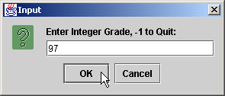
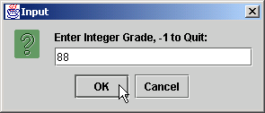

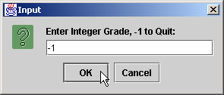
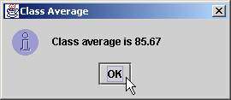
Average2.java
67 } // end method main
68
69 } // end class Average2

Slide 25
4.10 Formulating Algorithms with Top-Down, Stepwise Refinement: Case Study 3
(Nested Control Structures)
Nested control structures

Slide 26
Initialize passes to zero
Initialize failures to zero
Initialize student to one
While student counter is less than or equal to ten
Input the next exam result
If the student passed
Add one to passes
else
Add one to failures
Add one to student counter
Print the number of passes
Print the number of failures
If more than eight students passed
Print “Raise tuition”
Fig 4.10 Pseudocode for examination-results problem.

Slide 27
Analysis.java
Line 21
Line 31
1 // Fig. 4.11: Analysis.java
2 // Analysis of examination results.
3
4 // Java extension packages
5 import javax.swing.JOptionPane;
6
7 public class Analysis {
8
9 // main method begins execution of Java application
10 public static void main( String args[] )
11 {
12 // initializing variables in declarations
13 int passes = 0, // number of passes
14 failures = 0, // number of failures
15 student = 1, // student counter
16 result; // one exam result
17 String input, // user-entered value
18 output; // output string
19
20 // process 10 students; counter-controlled loop
21 while ( student <= 10 ) {
22
23 // obtain result from user
24 input = JOptionPane.showInputDialog(
25 "Enter result (1=pass,2=fail)" );
26
27 // convert result to int
28 result = Integer.parseInt( input );
29
30 // process result
31 if ( result == 1 )
32 passes = passes + 1;
33 else
34 failures = failures + 1;
Loop until student counter is greater than 10
Nested control structure

Slide 28
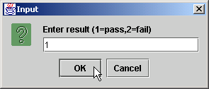
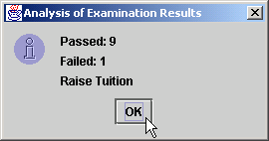
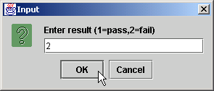
Analysis.java
35
36 student = student + 1;
37 }
38
39 // termination phase
40 output = "Passed: " + passes +
41 "\nFailed: " + failures;
42
43 if ( passes > 8 )
44 output = output + "\nRaise Tuition";
45
46 JOptionPane.showMessageDialog( null, output,
47 "Analysis of Examination Results",
48 JOptionPane.INFORMATION_MESSAGE );
49
50 System.exit( 0 ); // terminate application
51
52 } // end method main
53
54 } // end class Analysis

Slide 29
4.11 Assignment Operators
Assignment Operators
  Abbreviate assignment expressions
  Any statement of form
    variable = variable operator expression;
  Can be written as
    variable operator= expression;
  e.g., addition assignment operator +=
    c = c + 3
  can be written as
    c += 3

Slide 30
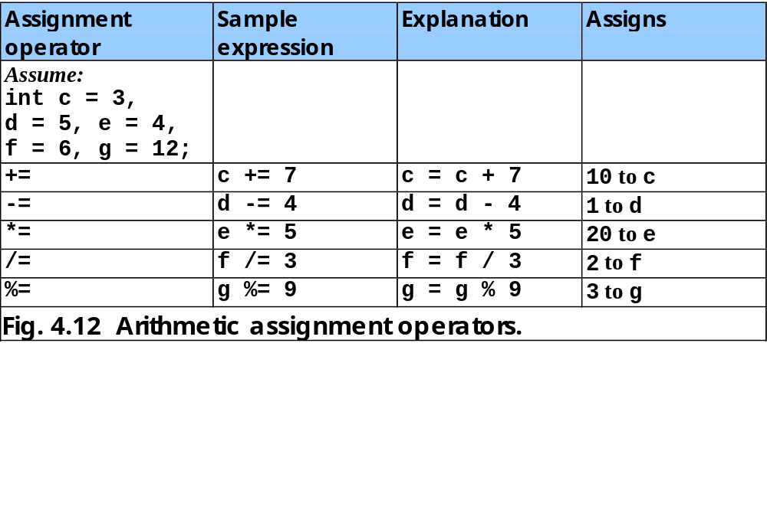

Slide 31
4.12 Increment and Decrement Operators
Unary increment operator (++)
  Increment variable’s value by 1
Unary decrement operator (--)
  Decrement variable’s value by 1
Preincrement / predecrement operator
Post-increment / post-decrement operator

Slide 32
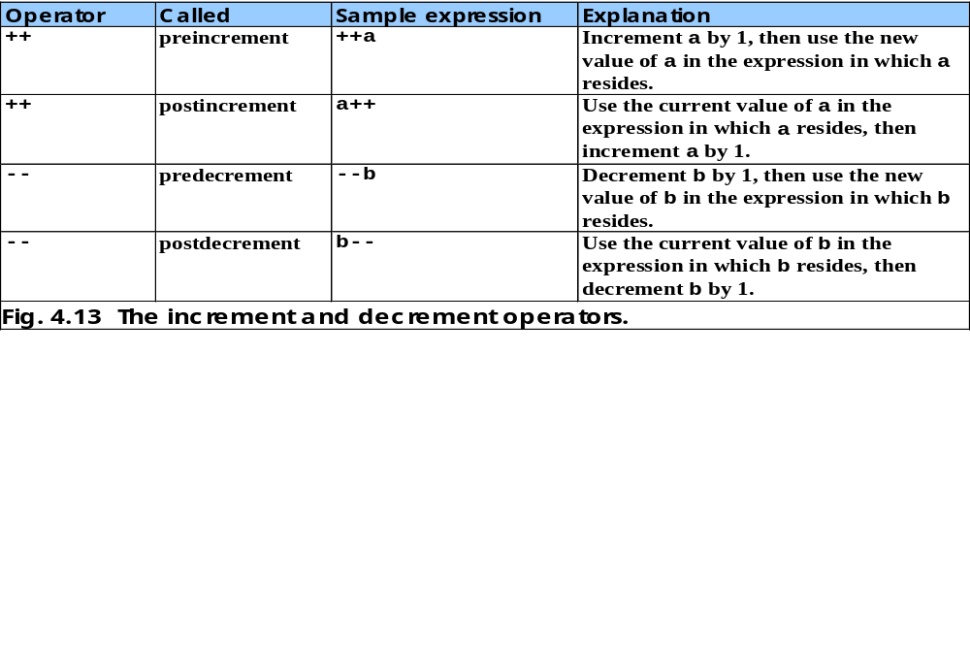

Slide 33
Increment.java
Line 13 postincrement
Line 20 preincrement
1 // Fig. 4.14: Increment.java
2 // Preincrementing and postincrementing
3
4 public class Increment {
5
6 // main method begins execution of Java application
7 public static void main( String args[] )
8 {
9 int c;
10
11 c = 5;
12 System.out.println( c ); // print 5
13 System.out.println( c++ ); // print 5 then postincrement
14 System.out.println( c ); // print 6
15
16 System.out.println(); // skip a line
17
18 c = 5;
19 System.out.println( c ); // print 5
20 System.out.println( ++c ); // preincrement then print 6
21 System.out.println( c ); // print 6
22
23 } // end method main
24
25 } // end class Increment
Line 13 postincrements c
Line 20 preincrements c
5
5
6
5
6
6

Slide 34
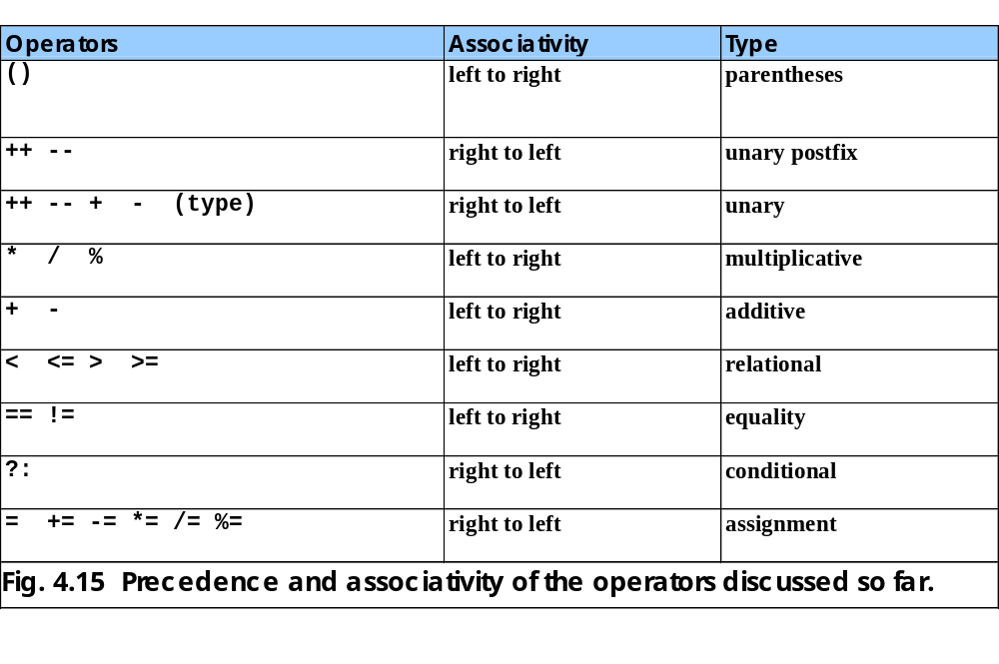

Slide 35
4.13 Primitive Data Types
Primitive types
  “building blocks” for more complicated types
Java is strongly typed
  All variables in a Java program must have a type
Java primitive types
  portable across computer platforms that support Java

Slide 36
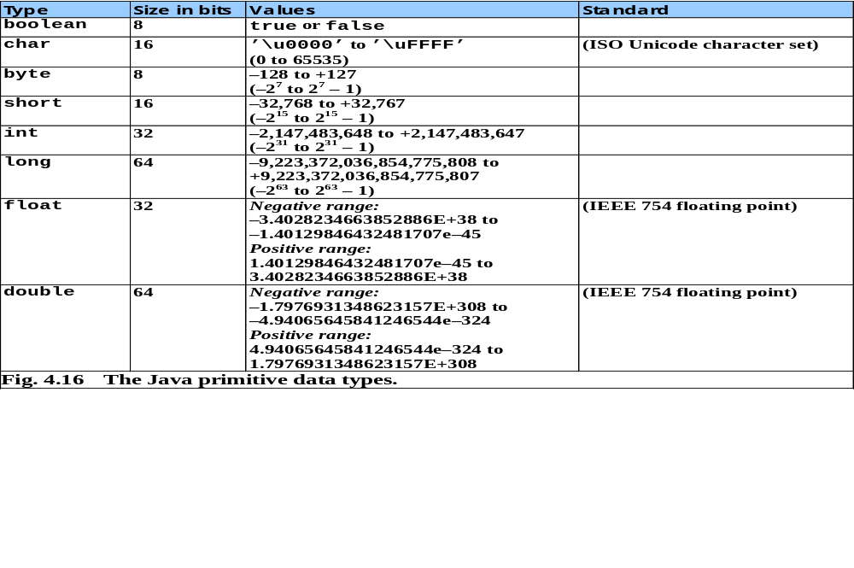

Slide 37
4.14 (Optional Case Study) Thinking About Objects: Identifying Class Attributes
Classes have attributes (data)
  Implemented in Java programs as variables
  Attributes of real-world objects
    Radio (object)
      Station setting, volume setting, AM or FM (attributes)
Identify attributes
  Look for descriptive words and phrases in problem statement
  Each identified word and phrase is a candidate attribute
    e.g., “the elevator is moving”
      “is moving” corresponds to boolean attribute moving
    e.g., “the elevator takes five seconds to travel between floors”
      corresponds to int attribute travelTime
        int travelTime = 5; (in Java)

Slide 38
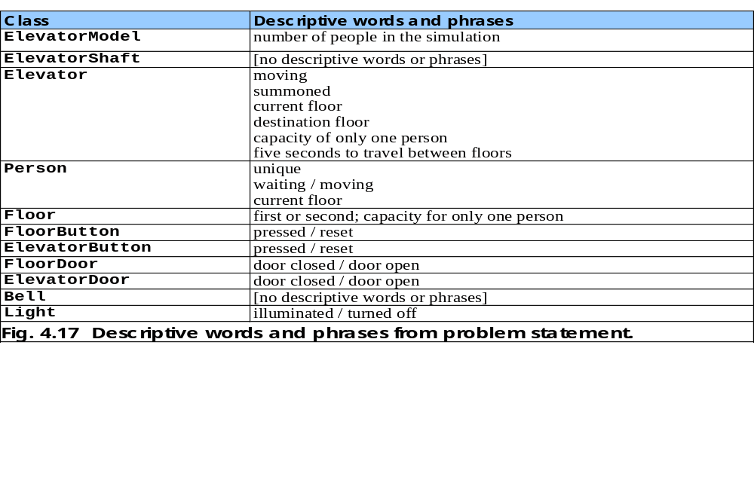

Slide 39
Identifying Class Attributes (cont.)
UML class diagram
  Class attributes are place in the middle compartment
  Attributes are written language independently
    e.g., attribute open of class ElevatorDoor
      open : Boolean = false
    May be coded in Java as
      boolean open = false;

Slide 40
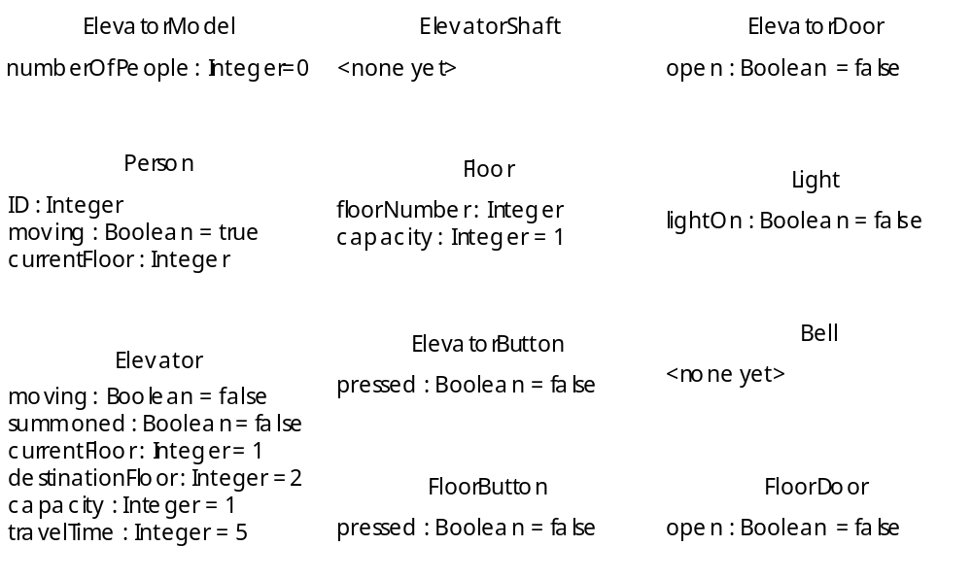
    Fig. 4.18 Classes with attributes.

